Slide 1
Database System
Lecture 11: Query Optimization
陈 刚
College of Computer Science
Zhejiang University
18667106736 / cg@zju.edu.cn
Lecture 11: Query Optimization — Database System

Slide 2

Outline
Introduction
Transformation of Relational Expressions
Statistics for Cost Estimation
*Dynamic Programming for Choosing Evaluation Plans
*Additional Optimization Techniques
Lecture 11: Query Optimization — Database System

Slide 3

Introduction
Alternative ways of evaluating a given query
  Equivalent expressions
  Different algorithms for each operation
Lecture 11: Query Optimization — Database System

Slide 4

Introduction (Cont.)
An evaluation plan defines exactly what algorithm is used for each operation, and how the execution of the operations is coordinated.
Find out how to view query execution plans on your favorite database
Lecture 11: Query Optimization — Database System

Slide 5
Introduction (Cont.)
Cost difference between evaluation plans for a query can be enormous
  E.g., seconds vs. days in some cases
Steps in cost-based query optimization
  Generate logically equivalent expressions using equivalence rules
  Annotate resultant expressions to get alternative query plans
  Choose the cheapest plan based on estimated cost
Estimation of plan cost based on:
  Statistical information about relations, e.g.,
    Number of tuples, number of distinct values for an attribute
  Statistics estimation for intermediate results
    To compute cost of complex expressions
  Cost formulae for algorithms, computed using statistics
Lecture 11: Query Optimization — Database System

Slide 6
Outline
Introduction
Transformation of Relational Expressions
Statistics for Cost Estimation
*Dynamic Programming for Choosing Evaluation Plans
*Additional Optimization Techniques
Lecture 11: Query Optimization — Database System

Slide 7
Transformation of Relational Expressions
Two relational algebra expressions are said to be equivalent if the two expressions generate the same set of tuples on every legal database instance.
  Note: order of tuples is irrelevant
  we don’t care if they generate different results on databases that violate integrity constraints
In SQL, inputs and outputs are multisets of tuples
  Two expressions in the multiset version of the relational algebra are said to be equivalent if the two expressions generate the same multiset of tuples on every legal database instance.
An equivalence rule says that expressions of two forms are equivalent
  Can replace expression of first form by second, or vice versa
Lecture 11: Query Optimization — Database System

Slide 8
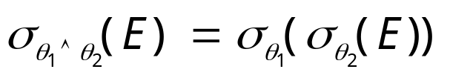


Equivalence Rules
1. Conjunctive selection operations can be deconstructed into a sequence of individual selections.
2. Selection operations are commutative.
3. Only the last in a sequence of projection operations is needed, the others can be omitted.
Selections can be combined with Cartesian products and theta joins.
  σ_{θ}(E₁ X E₂) = E₁ _{θ} E₂
  σ_{θ1}(E₁ _{θ2} E₂) = E₁ _{θ1∧ θ2} E₂
Lecture 11: Query Optimization — Database System

Slide 9
Equivalence Rules (Cont.)
5. Theta-join operations (and natural joins) are commutative.
E_{1 θ} E₂ = E₂ _{θ} E₁
6. (a) Natural join operations are associative:
(E₁ E₂) E₃ = E₁ (E₂ E₃)
(b) Theta joins are associative in the following manner:
(E_{1 θ1} E₂) _{θ2 ∧ θ3} E₃ = E_{1 θ1∧ θ3} (E₂ _{θ2} E₃)
where θ₂ involves attributes from only E₂ and E₃.
Lecture 11: Query Optimization — Database System

Slide 10

Pictorial Depiction of Equivalence Rules
Lecture 11: Query Optimization — Database System

Slide 11
Equivalence Rules (Cont.)
7. The selection operation distributes over the theta join operation under the following two conditions:
(a) When all the attributes in θ₀ involve only the attributes of one
of the expressions (E₁) being joined.
σ_{θ0}(E₁ _{θ} E₂) = (σ_{θ0}(E₁)) _{θ} E₂
(b) When θ ₁ involves only the attributes of E₁ and θ₂ involves
only the attributes of E₂.
σ_{θ1}∧_{θ2} (E₁ _{θ} E₂) = (σ_{θ1}(E₁)) _{θ} (σ_{θ2} (E₂))
(选择操作的分配律：先连后选＝>先选后连)
Lecture 11: Query Optimization — Database System

Slide 12
Equivalence Rules (Cont.)
The projection operation distributes over the theta join operation as follows:(投影操作在下面二个条件下对连接运算具有分配律：先连后投=►先投后连)
(a) if θ involves only attributes from L₁ ∪ L₂:
(b) Consider a join E_{1 θ} E₂.
  Let L₁ and L₂ be sets of attributes from E₁ and E₂, respectively.
  Let L₃ be attributes of E₁ that are involved in join condition θ, but are not in L₁ ∪ L₂, and
  Let L₄ be attributes of E₂ that are involved in join condition θ, but are not in L₁ ∪ L₂. （先连后投=>先投后连，再投影）
∏
(
E
E
)
=
(
∏
(
E
))
(
∏
(
E
))
L
1
∪
L
2
1
θ
2
L
1
1
θ
L
2
2
∏
(
E
E
)
=
∏
((
∏
(
E
))
(
∏
(
E
)))
L
1
∪
L
2
1
θ
2
L
1
∪
L
2
L
1
∪
L
3
1
θ
L
2
∪
L
4
2
Lecture 11: Query Optimization — Database System

Slide 13
Equivalence Rules (Cont.)
The set operations union and intersection are commutative
E₁ ∪ E₂ = E₂ ∪ E₁
E₁ ∩ E₂ = E₂ ∩ E₁
  (set difference is not commutative).
Set union and intersection are associative.
(E₁ ∪ E₂) ∪ E₃ = E₁ ∪ (E₂ ∪ E₃)
(E₁ ∩ E₂) ∩ E₃ = E₁ ∩ (E₂ ∩ E₃)
The selection operation distributes over ∪, ∩ and –.
σ_{θ} (E₁ – E₂) = σ_{θ} (E₁) – σ_{θ}(E₂)
and similarly for ∪ and ∩ in place of –
Also: σ_{θ} (E₁ – E₂) = σ_{θ}(E₁) – E₂
and similarly for ∩ in place of –, but not for ∪
12. The projection operation distributes over union
Π_{L}(E₁ ∪ E₂) = (Π_{L}(E₁)) ∪ (Π_{L}(E₂))
Lecture 11: Query Optimization — Database System

Slide 14
Transformation Example: Pushing Selections
Query: find the names of all instructors in the Music department, along with the titles of the courses that they teach
  Π_{name, title}(σ_{dept_name= “Music”}
  (instructor (teaches Π_{course_id, title} (course))))
Transformation using rule 7a.
  Π_{name, title}((σ_{dept_name= “Music”}(instructor))
  (teaches Π_{course_id, title} (course)))
Performing the selection as early as possible reduces the size of the relation to be joined.
Lecture 11: Query Optimization — Database System

Slide 15
Example with Multiple Transformations
Query: Find the names of all instructors in the Music department who have taught a course in 2009, along with the titles of the courses that they taught
  Π_{name, title}(σ_{dept_name= “Music”∧year = 2009}
  (instructor (teaches Π_{course_id, title} (course))))
Transformation using join associatively (Rule 6a):
  Π_{name, title}(σ_{dept_name= “Music”∧year = 2009}
  ((instructor teaches) Π_{course_id, title} (course)))
Second form provides an opportunity to apply the “perform selections early” rule, resulting in the subexpression
σ_{dept_name = “Music”} (instructor) σ _{year = 2009} (teaches)
Lecture 11: Query Optimization — Database System

Slide 16

Multiple Transformations
Lecture 11: Query Optimization — Database System

Slide 17
Transformation Example: Pushing Projections
Consider: Π_{name, title}(σ_{dept_name= “Music”} (instructor) teaches)
Π_{course_id, title} (course)
When we compute
(σ_{dept_name = “Music”} (instructor teaches))
we obtain a relation whose schema is:
(ID, name, dept_name, salary, course_id, sec_id, semester, year)
Push projections using equivalence rules 8a and 8b; eliminate unneeded attributes from intermediate results to get:
Π_{name, title}(Π_{name, course_id} (
σ_{dept_name= “Music”} (instructor) teaches))
Π_{course_id, title} (course)
Performing the projection as early as possible reduces the size of the relation to be joined.
Lecture 11: Query Optimization — Database System

Slide 18
Join Ordering Example
The ordering of join is important for reducing the size of temporary
results.
For all relations r_{1,} r_{2,} and r₃
(r₁ r₂) r₃ = r₁ (r₂ r₃ )
(Join Associativity)
If r₂ r₃ is quite large and r₁ r₂ is small, we choose
(r₁ r₂) r₃
so that we compute and store a smaller temporary relation.
Lecture 11: Query Optimization — Database System

Slide 19
Join Ordering Example (Cont.)
Consider the expression
Π_{name, title}(σ_{dept_name= “Music”} (instructor) teaches)
Π_{course_id, title} (course)
Could compute teaches Π_{course_id, title} (course) first, and then join the result with
σ_{dept_name=“Music”} (instructor)
but the result of the first join is likely to be a large relation.
Only a small fraction of the university’s instructors are likely to be from the Music department
  It is better to compute
σ_{dept_name= “Music”} (instructor) teaches
first.
Lecture 11: Query Optimization — Database System

Slide 20
Enumeration of Equivalent Expressions
Query optimizers use equivalence rules to systematically generate expressions equivalent to the given expression
Can generate all equivalent expressions as follows:
  Repeat
    Apply all applicable equivalence rules on every subexpression of every equivalent expression found so far
    Add newly generated expressions to the set of equivalent expressions
  Until no new equivalent expressions are generated above
The above approach is very expensive in space and time
  Two approaches
    Optimized plan generation based on transformation rules
    Special case approach for queries with only selections, projections and joins
Lecture 11: Query Optimization — Database System

Slide 21
Cost Estimation
Cost of each operator computer as described in Chapter 12
  Need statistics of input relations
    E.g., number of tuples, sizes of tuples, etc.
Inputs can be results of sub-expressions
  Need to estimate statistics of expression results
  To do so, we require additional statistics
    E.g., number of distinct values for an attribute
More on cost estimation later
Lecture 11: Query Optimization — Database System

Slide 22
Outline
Introduction
Transformation of Relational Expressions
Statistics for Cost Estimation
*Dynamic Programming for Choosing Evaluation Plans
*Additional Optimization Techniques
Lecture 11: Query Optimization — Database System

Slide 23
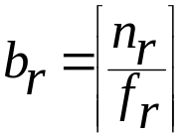
Statistical Information for Cost Estimation
n_{r}: number of tuples in a relation r.
b_{r}: number of blocks containing tuples of r.
l_{r}: size of a tuple of r.
f_{r}: blocking factor of r — i.e., the number of tuples of r that fit into one block.
V(A, r): number of distinct values that appear in r for attribute A; same as the size of ∏_{A}(r).
If tuples of r are stored together physically in a file, then:
Lecture 11: Query Optimization — Database System

Slide 24
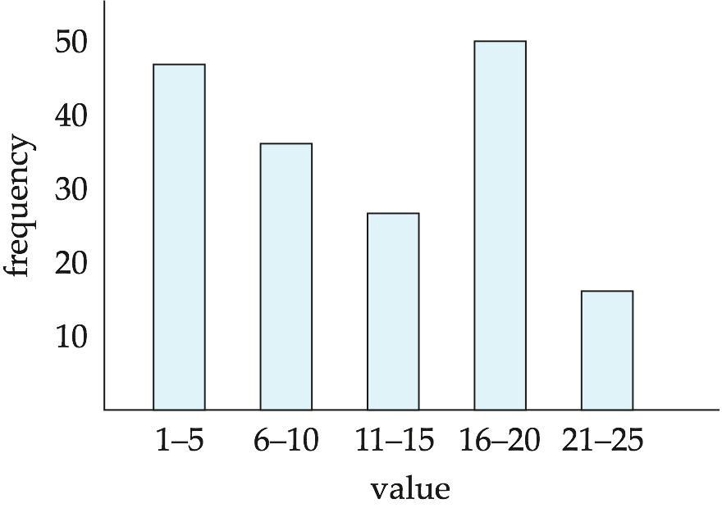
Histograms
Histogram on attribute age of relation person
Equi-width histograms
Equi-depth histograms

Slide 25
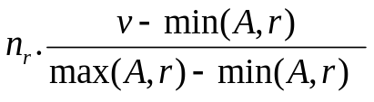
Selection Size Estimation
σ_{A=v}(r)
    n_{r} / V(A, r): number of records that will satisfy the selection
    Equality condition on a key attribute: size estimate = 1
σ_{A≤V}(r) (case of σ_{A ≥ V}(r) is symmetric)
  Let c denote the estimated number of tuples satisfying the condition.
  If min(A, r) and max(A, r) are available in catalog
    c = 0 if v < min(A, r)
    c =
  If histograms available, can refine above estimate
  In absence of statistical information c is assumed to be n_{r} / 2.

Slide 26
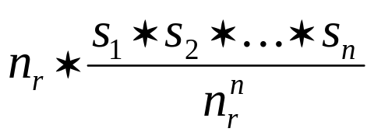
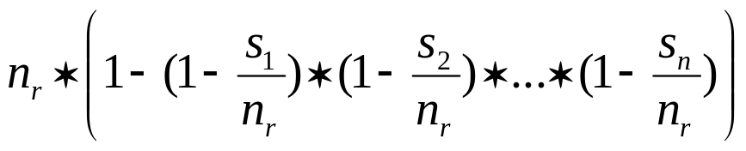
Size Estimation of Complex Selections
The selectivity of a condition θ_{i} is the probability that a tuple in the relation r satisfies θ_{i} .
  If s_{i} is the number of satisfying tuples in r, then the selectivity of θ_{i} is given by s_{i} / n_{r}.
Conjunction: σ_{θ1∧ θ2∧. . . ∧ θn} (r). Assuming indepdence, estimate of
tuples in the result is:
Disjunction: σ_{θ1∨} _{θ2 ∨. . . ∨} _{θn} (r). Estimated number of tuples:
Negation: σ_{¬θ}(r). Estimated number of tuples: n_{r} – size(σ_{θ}(r))
Lecture 11: Query Optimization — Database System

Slide 27
Estimation of the Size of Joins
The Cartesian product r x s contains n_{r} • n_{s} tuples; each tuple occupies s_{r} + s_{s} bytes.
If R ∩ S = ∅, then r s is the same as r x s.
If R ∩ S is a key for R, then a tuple of s will join with at most one tuple from r
  Therefore, the number of tuples in r s is no greater than the number of tuples in s.
If R ∩ S in S is a foreign key in S referencing R, then the number of tuples in r s is exactly the same as the number of tuples in s.
    The case for R ∩ S being a foreign key referencing S is symmetric.
In the example query student takes, ID in takes is a foreign key referencing student
  Hence, the result has exactly n_{takes} tuples, which is 10000
Lecture 11: Query Optimization — Database System

Slide 28


Estimation of the Size of Joins (Cont.)
If R ∩ S = {A} is not a key for R or S.
If we assume that every tuple t in R produces tuples in R S, the number of tuples in R S is estimated to be:
If the reverse is true, the estimate obtained will be:
The lower of these two estimates is probably the more accurate one.
Can improve on above if histograms are available
  Use formula similar to above, for each cell of histograms on the two relations
Lecture 11: Query Optimization — Database System

Slide 29
Join Operation: Running Example
Running example:
student takes
Catalog information for join examples:
n_{student} = 5,000.
f_{student} = 50, which implies that
b_{student} = 5000/50 = 100.
n_{takes} = 10000.
f_{takes} = 25, which implies that
b_{takes} = 10000/25 = 400.
V(ID, takes) = 2500, which means that on average, each student who has taken a course has taken 4 courses.
  Attribute ID in takes is a foreign key referencing student.
V(ID, student) = 5000 (primary key!)
Lecture 11: Query Optimization — Database System

Slide 30
Join Operation: Running Example (Cont.)
Compute the size estimates for student takes without using information about foreign keys:
  V(ID, takes) = 2500, and V(ID, student) = 5000
  The two estimates are 5000 * 10000/2500 = 20,000 and 5000 * 10000/5000 = 10000
  We choose the lower estimate, which in this case, is the same as our earlier computation using foreign keys.
Lecture 11: Query Optimization — Database System

Slide 31
Size Estimation for Other Operations
Projection: estimated size of ∏_{A}(r) = V(A, r)
Aggregation: estimated size of _{A}g_{F}(r) = V(A, r)
Outer join:
  Estimated size of r s = size of r s + size of r
    Case of right outer join is symmetric
  Estimated size of r s = size of r s + size of r + size of s
Set operations
  For unions/intersections of selections on the same relation: rewrite and use size estimate for selections
    E.g., σ_{θ1} (r) ∪ σ_{θ2} (r) can be rewritten as σ_{θ1} σ_{θ2} (r)
  For operations on different relations:
    Estimated size of r ∪ s = size of r + size of s.
    Estimated size of r ∩ s = minimum size of r and size of s.
    Estimated size of r – s = r.
    All the three estimates may be quite inaccurate, but provide upper bounds on the sizes.
Lecture 11: Query Optimization — Database System

Slide 32
Estimation of Number of Distinct Values
Selections: σ_{θ} (r)
If θ forces A to take a specified value: V(A,σ_{θ} (r)) = 1.
    E.g., A = 3
If θ forces A to take on one of a specified set of values:
V(A,σ_{θ} (r)) = number of specified values.
    E.g., (A = 1 V A = 3 V A = 4 ))
If the selection condition θ is of the form A op r
estimated V(A, σ_{θ} (r)) = V(A.r) * s
    Where s is the selectivity of the selection.
In all the other cases: use approximate estimate of
min(V(A,r), n_{σθ (r)} )
  More accurate estimate can be got using probability theory, but this one works fine generally
Lecture 11: Query Optimization — Database System

Slide 33
Estimation of Distinct Values (Cont.)
Joins: r s
If all attributes in A are from r
estimated V(A, r s) = min (V(A, r), n_{r s})
If A contains attributes A1 from r and A2 from s, then estimated
V(A, r s) =
min(V(A1, r)*V(A2 – A1, s), V(A1 – A2, r)*V(A2, s), n_{r s})
  More accurate estimate can be got using probability theory, but this one works fine generally
Lecture 11: Query Optimization — Database System

Slide 34
Estimation of Distinct Values (Cont.)
Estimation of distinct values are straightforward for projections.
  They are the same in ∏_{A (r)} as in r.
The same holds for grouping attributes of aggregation.
For aggregated values
  For min(A) and max(A), the number of distinct values can be estimated as min(V(A, r), V(G, r)) where G denotes grouping attributes
  For other aggregates, assume all values are distinct, and use V(G, r)
Lecture 11: Query Optimization — Database System

Slide 35
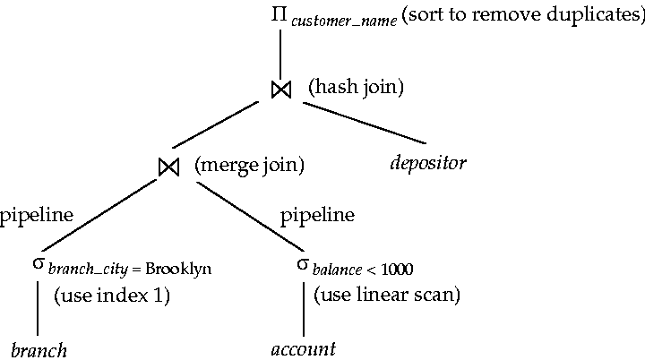
Evaluation plan
Lecture 11: Query Optimization — Database System

Slide 36
Choice of Evaluation Plans
Must consider the interaction of evaluation techniques when choosing evaluation plans
  Choosing the cheapest algorithm for each operation independently may not yield best overall algorithm, e.g.,
    Merge-join may be costlier than hash-join, but may provide a sorted output which reduces the cost for an outer level aggregation.
    Nested-loop join may provide opportunity for pipelining
Practical query optimizers incorporate elements of the following two broad approaches:
  1. Search all the plans and choose the best plan in a
  cost-based fashion.
  2. Uses heuristics to choose a plan.
Lecture 11: Query Optimization — Database System

Slide 37
Cost-Based Optimization
Consider finding the best join-order for r₁ r₂ . . . r_{n}.
There are (2(n – 1))!/(n – 1)! different join orders for above expression. With n = 7, the number is 665280, with n = 10, the number is greater than 176 billion!
No need to generate all the join orders. Using dynamic programming, the least-cost join order for any subset of
{r₁, r₂, . . . r_{n}} is computed only once and stored for future use.
Lecture 11: Query Optimization — Database System

Slide 38
Outline
Introduction
Transformation of Relational Expressions
Statistics for Cost Estimation
*Dynamic Programming for Choosing Evaluation Plans
*Additional Optimization Techniques
Lecture 11: Query Optimization — Database System

Slide 39
*Dynamic Programming in Optimization
To find best join tree for a set of n relations:
  To find best plan for a set S of n relations, consider all possible plans of the form: S₁ (S – S₁) where S₁ is any non-empty subset of S.
  Recursively compute costs for joining subsets of S to find the cost of each plan. Choose the cheapest of the 2^{n} – 2 alternatives.
  Base case for recursion: single relation access plan
    Apply all selections on R_{i} using best choice of indices on R_{i}
  When plan for any subset is computed, store it and reuse it when it is required again, instead of recomputing it
    Dynamic programming
Lecture 11: Query Optimization — Database System

Slide 40
Join Order Optimization Algorithm
procedure findbestplan(S)
if (bestplan[S].cost ≠ ∞)
return bestplan[S]
// else bestplan[S] has not been computed earlier, compute it now
if (S contains only 1 relation)
set bestplan[S].plan and bestplan[S].cost based on the best way
of accessing S /* Using selections on S and indices on S */
else for each non-empty subset S1 of S such that S1 ≠ S
P1= findbestplan(S1)
P2= findbestplan(S - S1)
A = best algorithm for joining results of P1 and P2
cost = P1.cost + P2.cost + cost of A
if cost < bestplan[S].cost
bestplan[S].cost = cost
bestplan[S].plan = “execute P1.plan; execute P2.plan;
join results of P1 and P2 using A”
return bestplan[S]
Lecture 11: Query Optimization — Database System

Slide 41
Cost of Optimization
With dynamic programming time complexity of optimization with bushy trees is O(3^{n}).
  With n = 10, this number is 59000 instead of 176 billion!
Space complexity is O(2^{n})
To find best left-deep join tree for a set of n relations:
  Consider n alternatives with one relation as right-hand side input and the other relations as left-hand side input.
  Modify optimization algorithm:
    Replace “for each non-empty subset S1 of S such that S1 ≠ S”
    By: for each relation r in S
    let S1 = S – r .
If only left-deep trees are considered, time complexity of finding best join order is O(n 2^{n})
  Space complexity remains at O(2^{n})
Cost-based optimization is expensive, but worthwhile for queries on large datasets (typical queries have small n, generally < 10)
Lecture 11: Query Optimization — Database System

Slide 42
Interesting Sort Orders
Consider the expression (r₁ r₂) r₃ (with A as common attribute)
An interesting sort order is a particular sort order of tuples that could be useful for a later operation
  Using merge-join to compute r₁ r₂ may be costlier than hash join but generates result sorted on A
  Which in turn may make merge-join with r₃ cheaper, which may reduce cost of join with r₃ and minimizing overall cost
  Sort order may also be useful for order by and for grouping
Not sufficient to find the best join order for each subset of the set of n given relations
  must find the best join order for each subset, for each interesting sort order
  Simple extension of earlier dynamic programming algorithms
  Usually, number of interesting orders is quite small and doesn’t affect time/space complexity significantly
Lecture 11: Query Optimization — Database System

Slide 43
Cost Based Optimization with Equivalence Rules
Physical equivalence rules allow logical query plan to be converted to physical query plan specifying what algorithms are used for each operation.
Efficient optimizer based on equivalent rules depends on
  A space efficient representation of expressions which avoids making multiple copies of subexpressions
  Efficient techniques for detecting duplicate derivations of expressions
  A form of dynamic programming based on memoization, which stores the best plan for a subexpression the first time it is optimized, and reuses in on repeated optimization calls on same subexpression
  Cost-based pruning techniques that avoid generating all plans
Pioneered by the Volcano project and implemented in the SQL Server optimizer
Lecture 11: Query Optimization — Database System

Slide 44
Heuristic Optimization
Cost-based optimization is expensive, even with dynamic programming.
Systems may use heuristics to reduce the number of choices that must be made in a cost-based fashion.
Heuristic optimization transforms the query-tree by using a set of rules that typically (but not in all cases) improve execution performance:
  Perform selection early (reduces the number of tuples)
  Perform projection early (reduces the number of attributes)
  Perform most restrictive selection and join operations (i.e. with smallest result size) before other similar operations.
  Some systems use only heuristics, others combine heuristics with partial cost-based optimization.
Lecture 11: Query Optimization — Database System

Slide 45
Structure of Query Optimizers
Many optimizers considers only left-deep join orders.
  Plus heuristics to push selections and projections down the query tree
  Reduces optimization complexity and generates plans amenable to pipelined evaluation.
Heuristic optimization used in some versions of Oracle:
  Repeatedly pick “best” relation to join next
    Starting from each of n starting points. Pick best among these
Intricacies of SQL complicate query optimization
  E.g., nested subqueries
Lecture 11: Query Optimization — Database System

Slide 46

Left Deep Join Trees
In left-deep join trees, the right-hand-side input for each join is a relation, not the result of an intermediate join.
Lecture 11: Query Optimization — Database System

Slide 47
Structure of Query Optimizers (Cont.)
Some query optimizers integrate heuristic selection and the generation of alternative access plans.
  Frequently used approach
    heuristic rewriting of nested block structure and aggregation
    followed by cost-based join-order optimization for each block
  Some optimizers (e.g. SQL Server) apply transformations to entire query and do not depend on block structure
  Optimization cost budget to stop optimization early (if cost of plan is less than cost of optimization)
  Plan caching to reuse previously computed plan if query is resubmitted
    Even with different constants in query
Even with the use of heuristics, cost-based query optimization imposes a substantial overhead.
  But is worth it for expensive queries
  Optimizers often use simple heuristics for very cheap queries, and perform exhaustive enumeration for more expensive queries
Lecture 11: Query Optimization — Database System

Slide 48
Outline
Introduction
Transformation of Relational Expressions
Statistics for Cost Estimation
*Dynamic Programming for Choosing Evaluation Plans
*Additional Optimization Techniques
Lecture 11: Query Optimization — Database System

Slide 49
Optimizing Nested Subqueries**
Nested query example:
select name
from instructor
where exists (select *
from teaches
where instructor.ID = teaches.ID and teaches.year = 2007)
SQL conceptually treats nested subqueries in the where clause as functions that take parameters and return a single value or set of values
  Parameters are variables from outer level query that are used in the nested subquery; such variables are called correlation variables
Conceptually, nested subquery is executed once for each tuple in the cross-product generated by the outer level from clause
  Such evaluation is called correlated evaluation
  Note: other conditions in where clause may be used to compute a join (instead of a cross-product) before executing the nested subquery
Lecture 11: Query Optimization — Database System

Slide 50
Optimizing Nested Subqueries (Cont.)
Correlated evaluation may be quite inefficient since
  a large number of calls may be made to the nested query
  there may be unnecessary random I/O as a result
SQL optimizers attempt to transform nested subqueries to joins where possible, enabling use of efficient join techniques
E.g.: earlier nested query can be rewritten as
select name
from instructor, teaches
where instructor.ID = teaches.ID and teaches.year = 2007
  Note: the two queries generate different numbers of duplicates (why?)
    teaches can have duplicate IDs
    Can be modified to handle duplicates correctly as we will see
In general, it is not possible/straightforward to move the entire nested subquery from clause into the outer level query from clause
  A temporary relation is created instead, and used in body of outer level query
Lecture 11: Query Optimization — Database System

Slide 51
Optimizing Nested Subqueries (Cont.)
In general, SQL queries of the form below can be rewritten as shown
Rewrite: select …
from L₁
where P₁ and exists (select *
from L₂
where P₂)
To: create table t₁ as
select distinct V
from L₂
where P₂¹
select …
from L₁, t₁
where P₁ and P₂²
  P₂¹ contains predicates in P₂ that do not involve any correlation variables
  P₂² reintroduces predicates involving correlation variables, with
  relations renamed appropriately
  V contains all attributes used in predicates with correlation variables
Lecture 11: Query Optimization — Database System

Slide 52
Optimizing Nested Subqueries (Cont.)
In our example, the original nested query would be transformed to
create table t₁ as
select distinct ID
from teaches
where year = 2007
select name
from instructor, t₁
where t₁.ID = instructor.ID
The process of replacing a nested query by a query with a join (possibly with a temporary relation) is called decorrelation.
Decorrelation is more complicated when
  the nested subquery uses aggregation, or
  when the result of the nested subquery is used to test for equality, or
  when the condition linking the nested subquery to the other
  query is not exists,
  and so on.
Lecture 11: Query Optimization — Database System

Slide 53
Materialized Views**
A materialized view is a view whose contents are computed and stored.
Consider the view
create view department_total_salary(dept_name, total_salary) as
select dept_name, sum(salary)
from instructor
group by dept_name
Materializing the above view would be very useful if the total salary by department is required frequently
  Saves the effort of finding multiple tuples and adding up their amounts
Lecture 11: Query Optimization — Database System

Slide 54
Materialized View Maintenance
The task of keeping a materialized view up-to-date with the underlying data is known as materialized view maintenance
Materialized views can be maintained by recomputation on every update
A better option is to use incremental view maintenance
  Changes to database relations are used to compute changes to the materialized view, which is then updated
View maintenance can be done by
  Manually defining triggers on insert, delete, and update of each relation in the view definition
  Manually written code to update the view whenever database relations are updated
  Periodic recomputation (e.g. nightly)
  Above methods are directly supported by many database systems
    Avoids manual effort/correctness issues
Lecture 11: Query Optimization — Database System

Slide 55
Incremental View Maintenance
The changes (inserts and deletes) to a relation or expressions are referred to as its differential
  Set of tuples inserted to and deleted from r are denoted i_{r} and d_{r}
To simplify our description, we only consider inserts and deletes
  We replace updates to a tuple by deletion of the tuple followed by insertion of the update tuple
We describe how to compute the change to the result of each relational operation, given changes to its inputs
We then outline how to handle relational algebra expressions
Lecture 11: Query Optimization — Database System

Slide 56
Join Operation
Consider the materialized view v = r s and an update to r
Let r^{old} and r^{new} denote the old and new states of relation r
Consider the case of an insert to r:
  We can write r^{new} s as (r^{old} ∪ i_{r}) s
  And rewrite the above to (r^{old} s) ∪ (i_{r} s)
  But (r^{old} s) is simply the old value of the materialized view, so the incremental change to the view is just i_{r} s
Thus, for inserts v^{new} = v^{old} ∪(i_{r} s)
Similarly for deletes v^{new} = v^{old} – (d_{r} s)
A, 1
B, 2
1, p
2, r
2, s
A, 1, p
B, 2, r
B, 2, s
C,2
C, 2, r
C, 2, s
Lecture 11: Query Optimization — Database System

Slide 57
Selection and Projection Operations
Selection: Consider a view v = σ_{θ}(r).
  v^{new} = v^{old} ∪σ_{θ}(i_{r})
  v^{new} = v^{old} - σ_{θ}(d_{r})
Projection is a more difficult operation
  R = (A,B), and r(R) = { (a,2), (a,3)}
  ∏_{A}(r) has a single tuple (a).
  If we delete the tuple (a,2) from r, we should not delete the tuple (a) from ∏_{A}(r), but if we then delete (a,3) as well, we should delete the tuple
For each tuple in a projection ∏_{A}(r) , we will keep a count of how many times it was derived
  On insert of a tuple to r, if the resultant tuple is already in ∏_{A}(r) we increment its count, else we add a new tuple with count = 1
  On delete of a tuple from r, we decrement the count of the corresponding tuple in ∏_{A}(r)
    if the count becomes 0, we delete the tuple from ∏_{A}(r)
Lecture 11: Query Optimization — Database System

Slide 58
Aggregation Operations
count : v = _{A}g_{count(B)}^{(r)}.
  When a set of tuples i_{r} is inserted
    For each tuple r in i_{r}, if the corresponding group is already present in v, we increment its count, else we add a new tuple with count = 1
  When a set of tuples d_{r} is deleted
    for each tuple t in i_{r.}we look for the group t.A in v, and subtract 1 from the count for the group.
      If the count becomes 0, we delete from v the tuple for the group t.A
sum: v = _{A}g_{sum (B)}^{(r)}
  We maintain the sum in a manner similar to count, except we add/subtract the B value instead of adding/subtracting 1 for the count
  Additionally we maintain the count in order to detect groups with no tuples. Such groups are deleted from v
    Cannot simply test for sum = 0 (why?)
To handle the case of avg, we maintain the sum and count
aggregate values separately, and divide at the end
Lecture 11: Query Optimization — Database System

Slide 59
Aggregate Operations (Cont.)
min, max: v = _{A}g_{min (B)} (r).
  Handling insertions on r is straightforward.
  Maintaining the aggregate values min and max on deletions may be more expensive. We have to look at the other tuples of r that are in the same group to find the new minimum
Lecture 11: Query Optimization — Database System

Slide 60
Other Operations
Set intersection: v = r ∩ s
  when a tuple is inserted in r we check if it is present in s, and if so we add it to v.
  If the tuple is deleted from r, we delete it from the intersection if it is present.
  Updates to s are symmetric
  The other set operations, union and set difference are handled in a similar fashion.
Outer joins are handled in much the same way as joins but with some extra work
  we leave details to you.
Lecture 11: Query Optimization — Database System

Slide 61
Handling Expressions
To handle an entire expression, we derive expressions for computing the incremental change to the result of each sub-expressions, starting from the smallest sub-expressions.
E.g., consider E₁ E₂ where each of E₁ and E₂ may be a complex expression
  Suppose the set of tuples to be inserted into E₁ is given by D₁
    Computed earlier, since smaller sub-expressions are handled first
  Then the set of tuples to be inserted into E₁ E₂ is given by
  D₁ E₂
    This is just the usual way of maintaining joins
Lecture 11: Query Optimization — Database System

Slide 62
Query Optimization and Materialized Views
Rewriting queries to use materialized views:
  A materialized view v = r s is available
  A user submits a query r s t
  We can rewrite the query as v t
    Whether to do so depends on cost estimates for the two alternative
Replacing a use of a materialized view by the view definition:
  A materialized view v = r s is available, but without any index on it
  User submits a query σ_{A=10}(v).
  Suppose also that s has an index on the common attribute B, and r has an index on attribute A.
  The best plan for this query may be to replace v by r s, which can lead to the query plan σ_{A=10}(r) s
Query optimizer should be extended to consider all above
alternatives and choose the best overall plan
Lecture 11: Query Optimization — Database System

Slide 63
Materialized View Selection
Materialized view selection: “What is the best set of views to materialize?”.
Index selection: “what is the best set of indices to create”
  closely related, to materialized view selection
    but simpler
Materialized view selection and index selection based on typical system workload (queries and updates)
  Typical goal: minimize time to execute workload , subject to constraints on space and time taken for some critical queries/updates
  One of the steps in database tuning
    more on tuning in later chapters
Commercial database systems provide tools (called “tuning assistants” or “wizards”) to help the database administrator choose what indices and materialized views to create
Lecture 11: Query Optimization — Database System

Slide 64

Q & A
Your questions and suggestions are expected for me.
Thanks a lot!
Exercises: 16.5, 15.6, 16.16, and 16.20 (See Pages 790-793)
Questions?
Lecture 11: Query Optimization — Database System

